Slide 1

Governance Commission
Meeting 1
August 19, 2011

Slide 2
HCR 184
. . . creates a commission to study governance, management, and supervision of postsecondary education. The resolution states that governance has been a perennial issue faced by the legislature since the adoption of the current constitution and there is general agreement in the legislature that there are problems with the current structure but no general agreement on a solution. Louisiana’s governance structure should provide strong policy leadership, drive institutional accountability and student achievement. The resolution further states that it is logical, reasonable, and imperative that postsecondary education institutions work within a cohesive and comprehensive governance framework that maximizes the application of scarce resources to the benefit of their students.

Slide 3
HCR 184
The resolution sets out specific tasks for the Commission resulting in two primary charges.
PART ONE: The Study
The Commission shall conduct a study that includes the examination of how an improved governance structure would result in:
More efficient use of resources by eliminating duplicative management arrangements and personnel
The improvement of student success by better alignment of student interests and abilities with appropriate institutions and credential options
Better integration of education at all secondary and postsecondary levels through development of a complete articulation and transfer plan
More fair and equitable service to all institutions through better representation in the management structure and fuller recognition and support for the special missions and needs of historically black colleges and universities

Slide 4
HCR 184
PART TWO: The Plan for Reorganization
The commission shall prepare and submit to the legislature a plan for reorganization of the governance, management, and supervision of postsecondary education, which shall include not only a proposal for a basic structural arrangement of entities, offices, and institutions but also:
Evaluation and conclusion regarding creation of a single board to govern public postsecondary institutions
A detailed articulation of the distribution of authority and responsibilities among entities, offices, and institutions
Recommendations for the proper mechanism for setting tuition and suggestions regarding the proper balance of state general funds and tuition as means of funding postsecondary education
Proposals regarding the distribution formula of state general funds and the relative importance of equity and performance in that formula
Timeline
The resolution states that the Commission is to submit a plan for reorganization to the legislature not later than sixty (60) days prior to the 2012 Regular Session of the Legislature of Louisiana which begins on March 12, 2012.

Slide 5

Authors
Representative Carmody
Representative Schroder

Slide 6







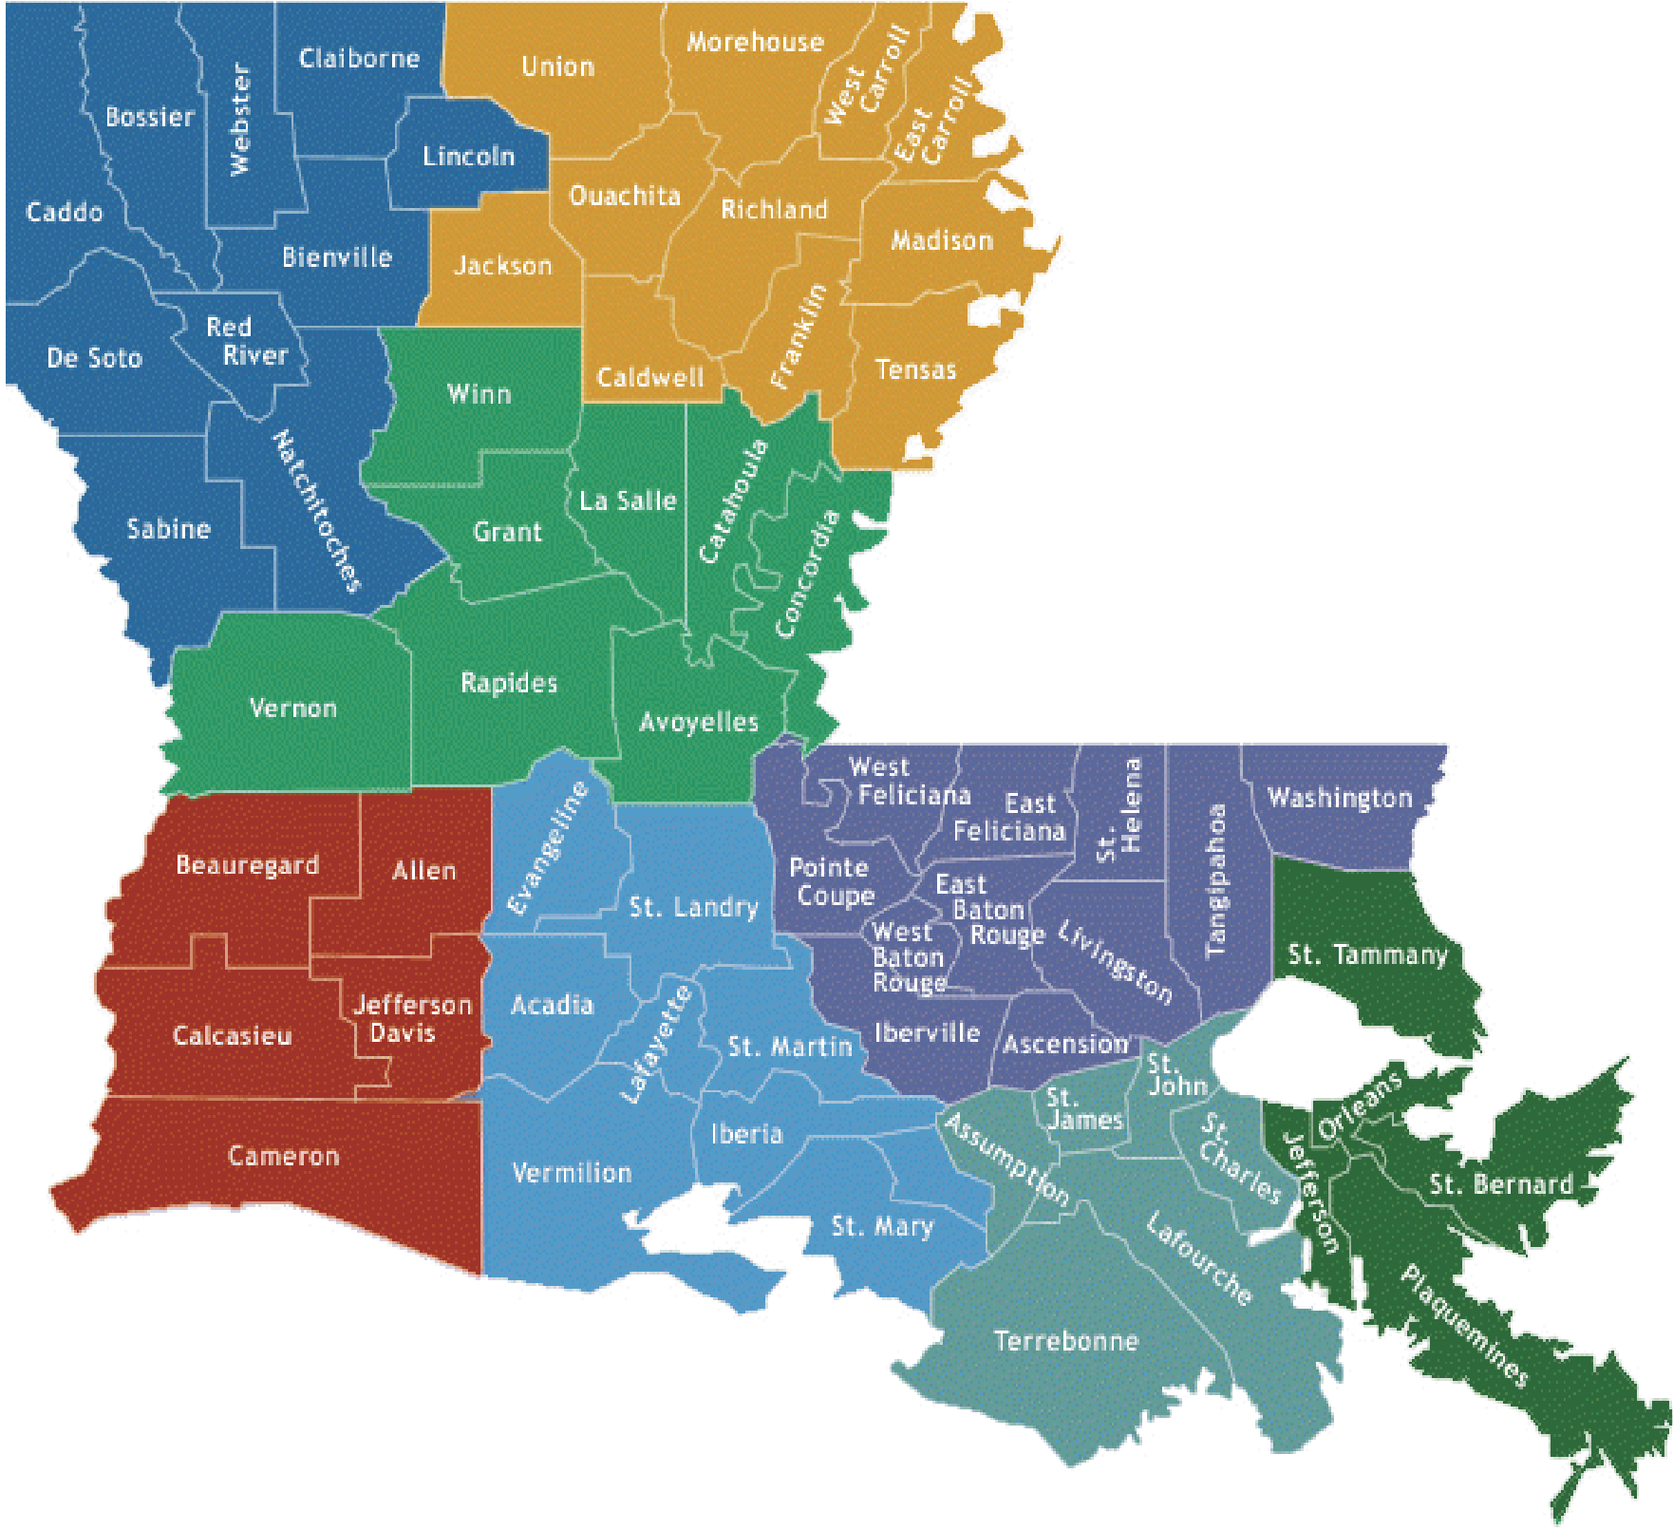





















Louisiana’s Public Colleges and Universities
Bossier Parish
LSU Health Sciences
Grambling State
Louisiana Tech
University of Louisiana
Community College
Center - Shreveport
University
University
Monroe
Louisiana Technical College
(7 colleges statewide)
Louisiana Delta
Southern
Community College
University- Shreveport
LSU - Alexandria
Louisiana State
LSU-Shreveport
Northwestern
University
Southern
State University
University
Baton Rouge
Community College
Southeastern Louisiana
McNeese State
University
University
University of New Orleans
SOWELA Technical
LSU - Eunice
Community College
Fletcher Technical
Delgado
LSU Health Sciences
Community College
River Parishes
Community College
Center - New Orleans
Community College
South Louisiana
Southern University
Community College
Nicholls State
Nunez
New Orleans
University
Community College
University of Louisiana
Lafayette
Notes:
USE THIS ONE

Slide 7
Annual Enrollment for Public Institutions
62% are enrolled in universities
11% are graduate students
59 % are women
30% are African-American
10% are out-of state and international students

Slide 8
First-Time Freshman Enrollment Mix

Slide 9
Matriculation Rates
One –Year Retention Rates
University: 72%
Community college: 47%
Graduation rates:
University (6-year rate): 42%
Community college (3-year rate): 6%

Slide 10
Student Preparation for College
Average ACT for Louisiana is 20.7 compared to 22 for the Nation as a whole
72% of entering freshmen at community colleges need remediation
21% of Entering freshmen at the universities need remediation
State minimum admission standards will redirect all students needing developmental education to the community colleges by 2014.

Slide 11
Certificates and Degrees Awarded

Slide 12
Certificates and Degrees Awarded
382% - Certificates
55% - Diplomas
51% Associate Degrees
8% Baccalaureate Degrees
-2% Master Degrees
5% Doctoral Degrees
Notes:
FY 2011 38425

Slide 13
Sources of Revenue
ARRA funds are included in “Other” for FY 2010 and FY 2011.

Slide 14
Student Aid

Slide 15
Performance Initiatives
Performance Funding Formula
Grad Act
Articulation transfer degree
Increase admission standards for universities
Academic Program review – termination of under-performing programs

Slide 16
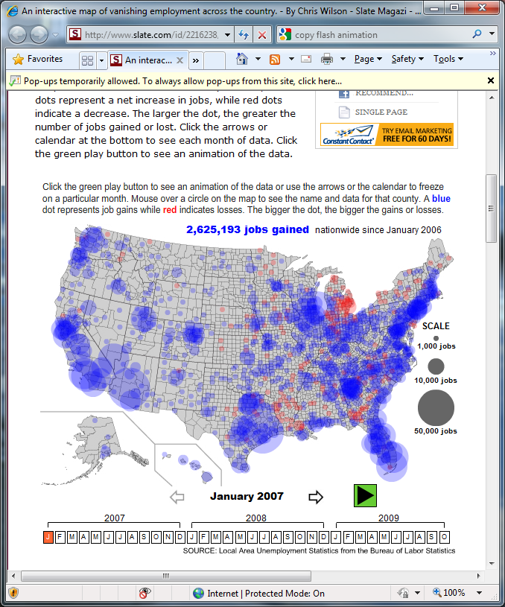

Slide 17
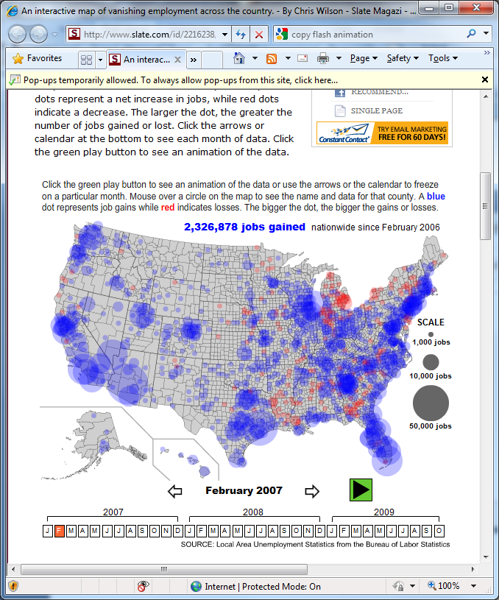

Slide 18


Slide 19
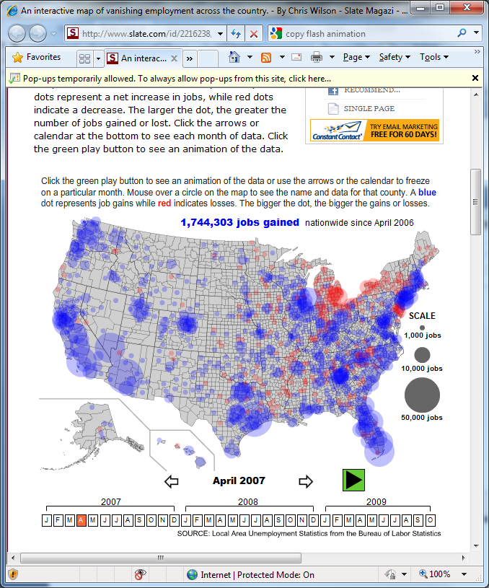

Slide 20
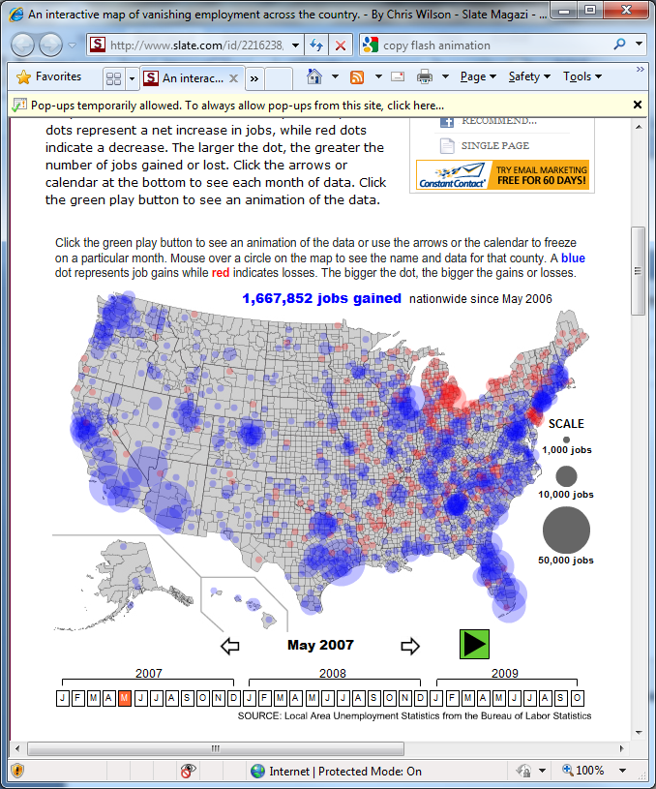

Slide 21
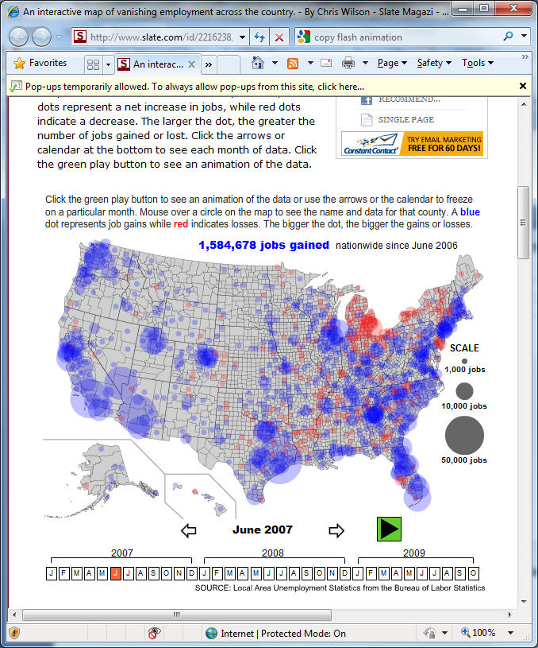

Slide 22


Slide 23


Slide 24
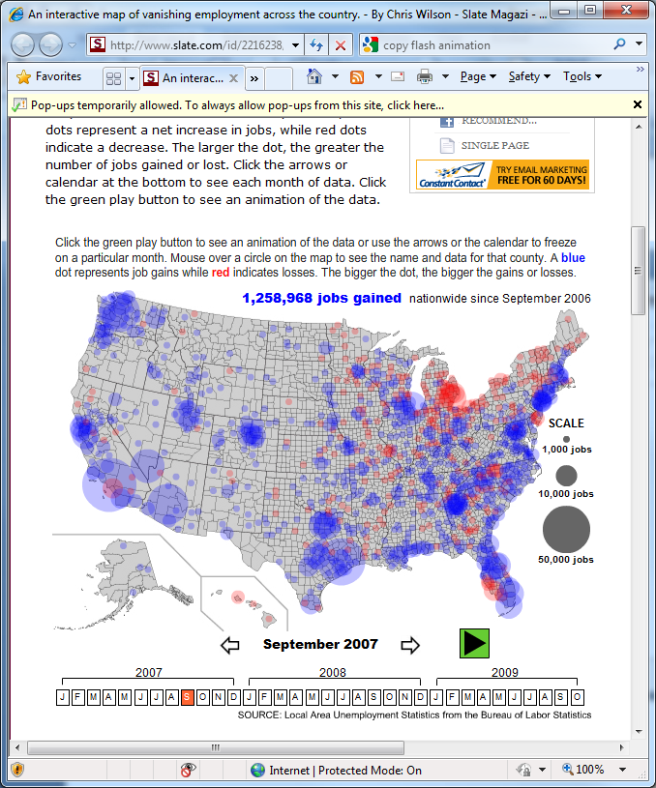

Slide 25
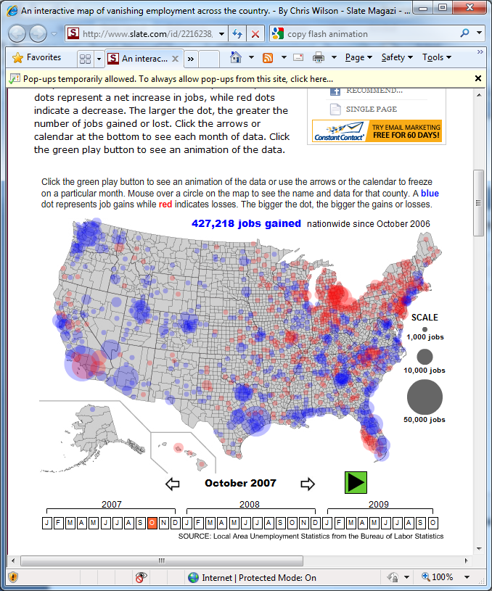

Slide 26
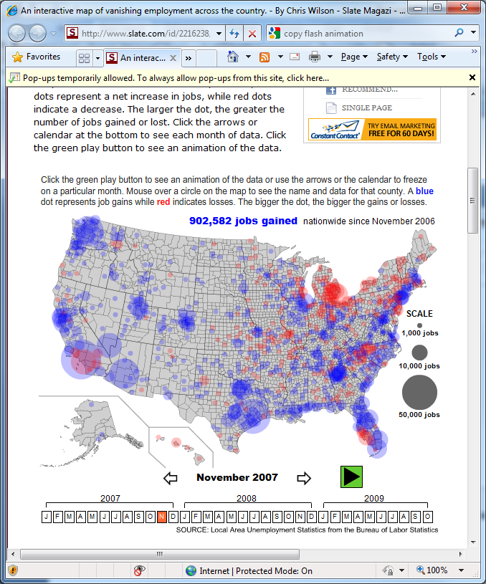

Slide 27
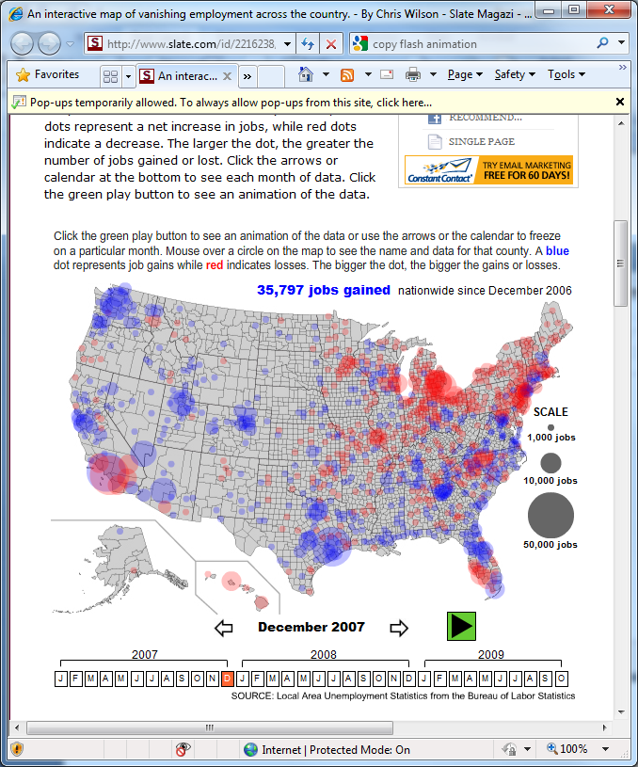

Slide 28
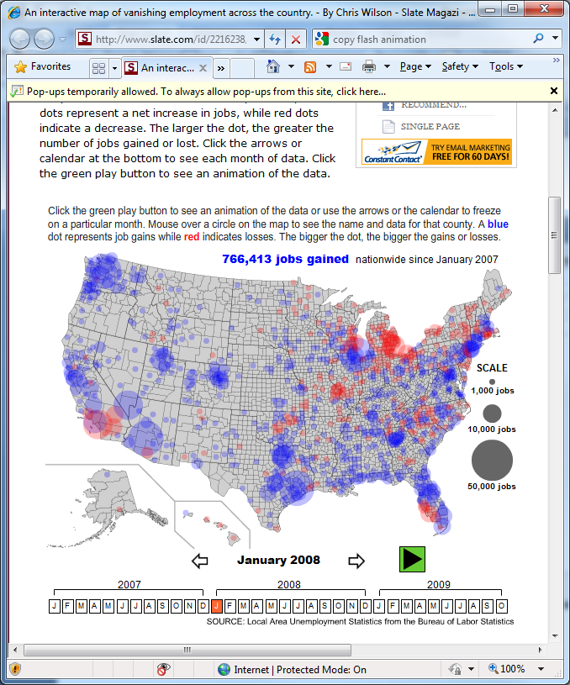

Slide 29
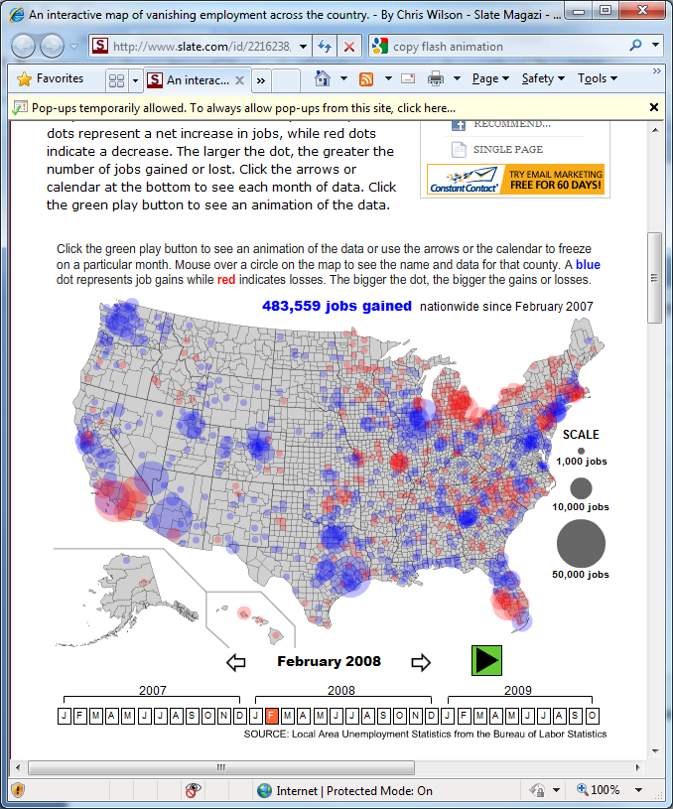

Slide 30
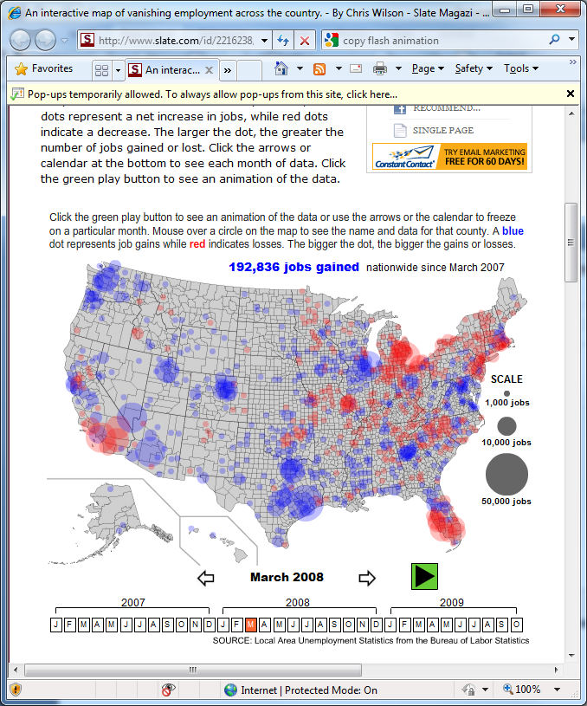

Slide 31
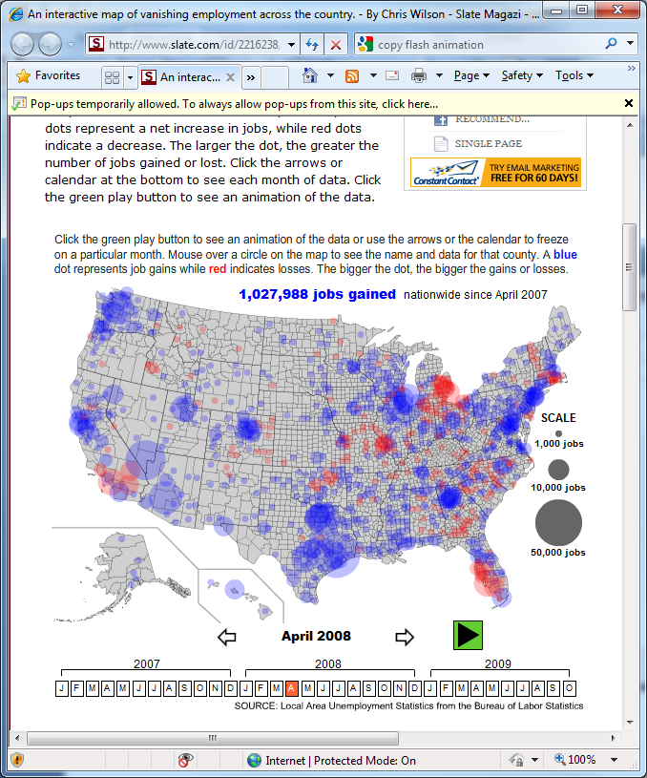

Slide 32
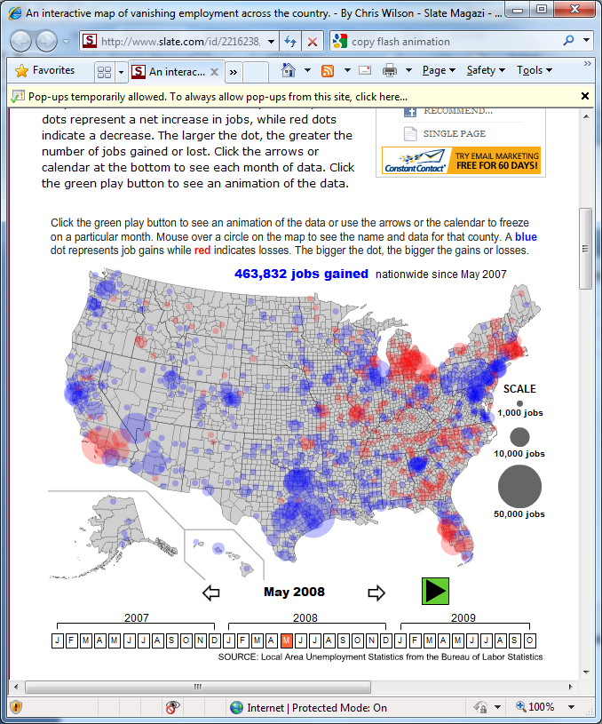

Slide 33
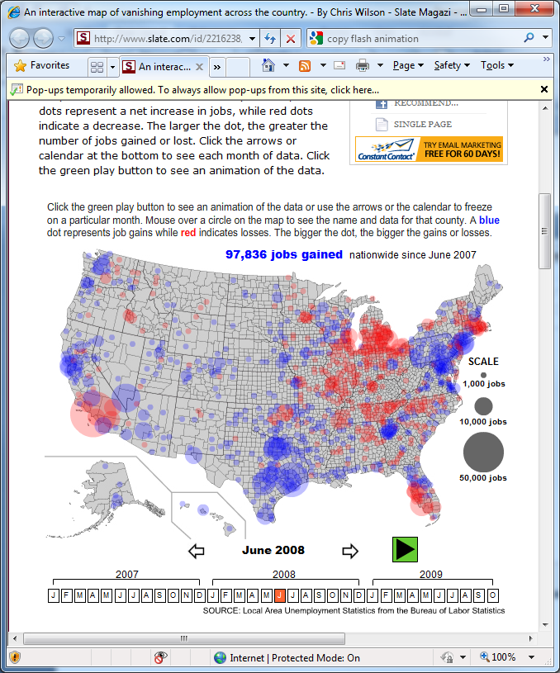

Slide 34
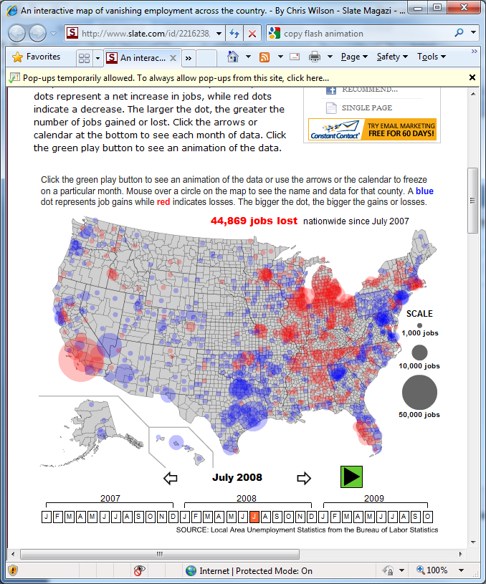

Slide 35
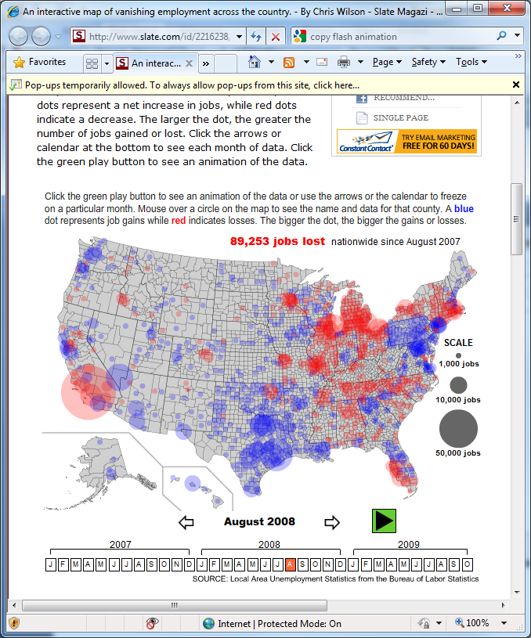

Slide 36
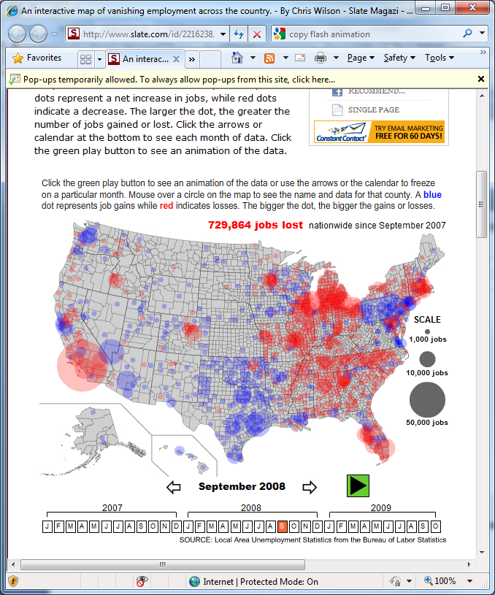

Slide 37


Slide 38
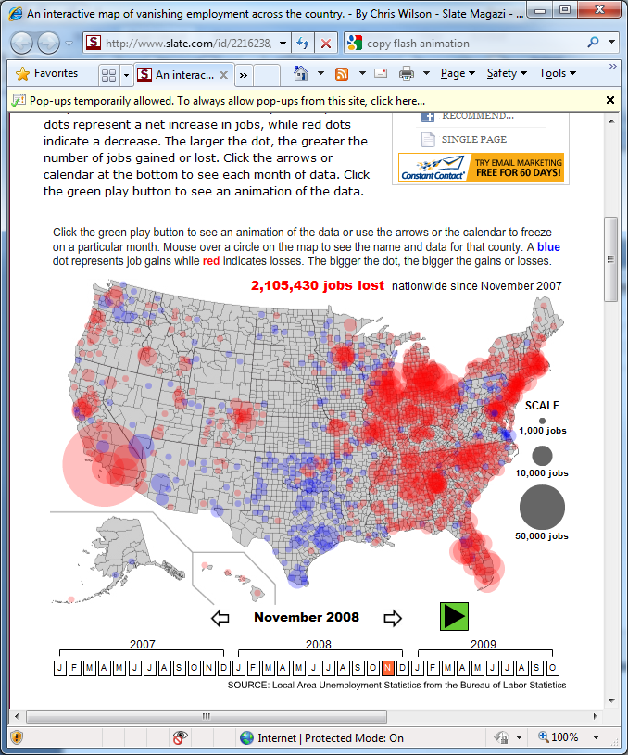

Slide 39
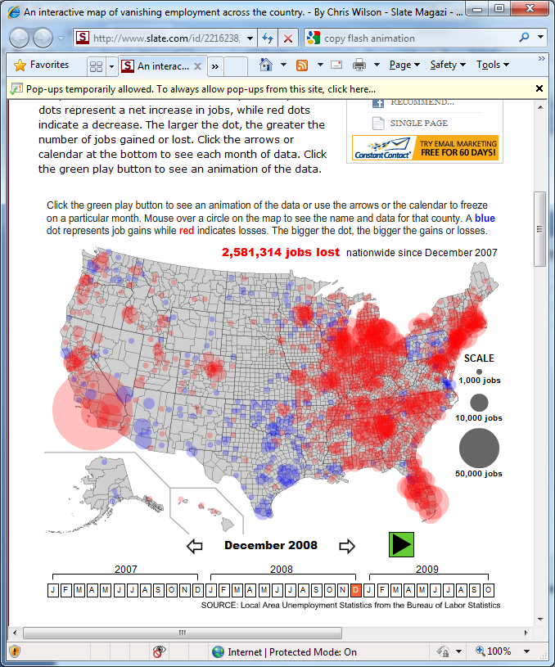

Slide 40
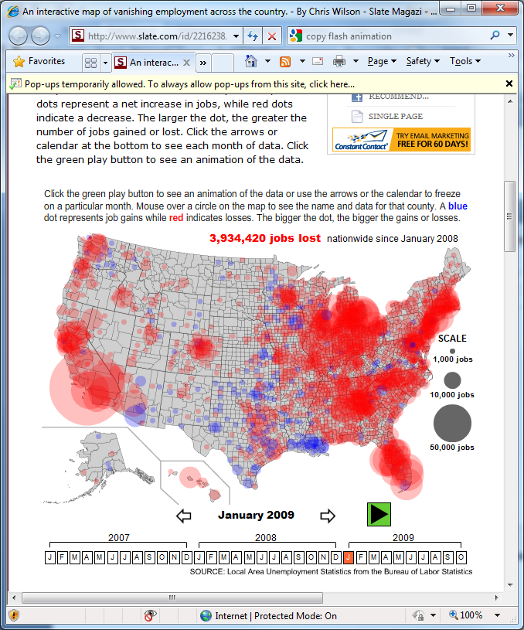

Slide 41
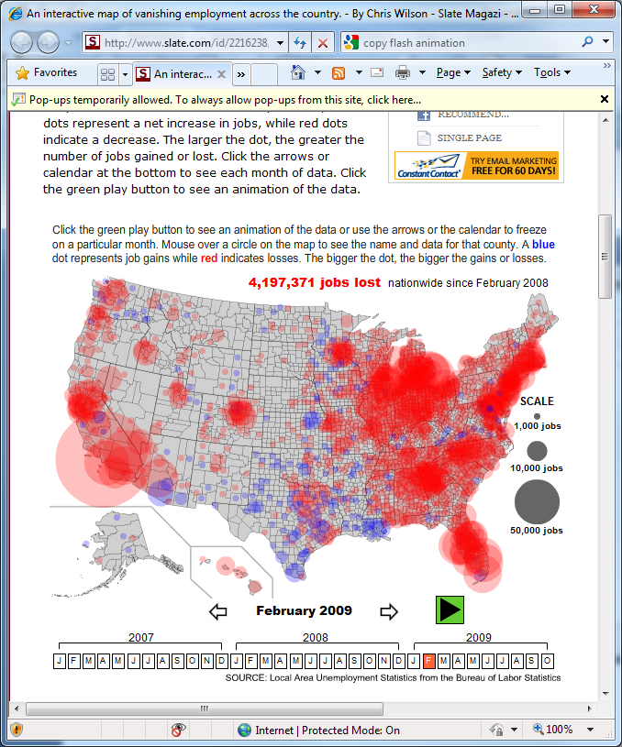

Slide 42
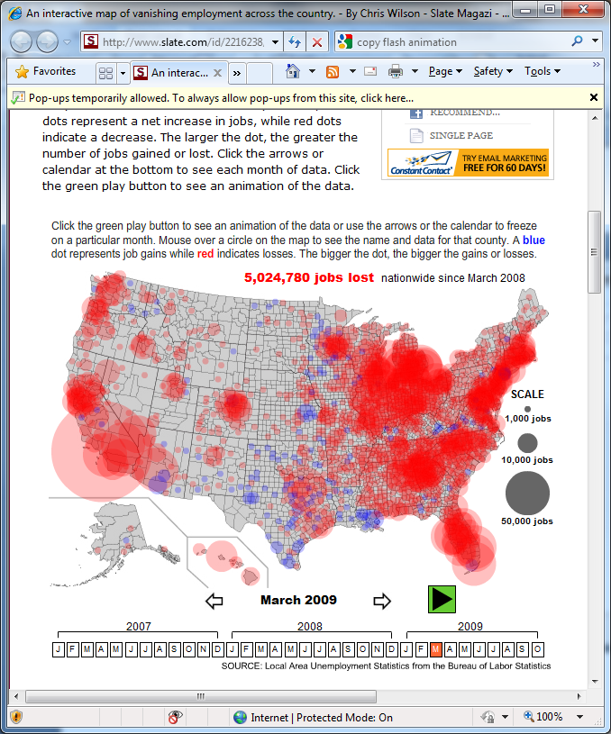

Slide 43


Slide 44
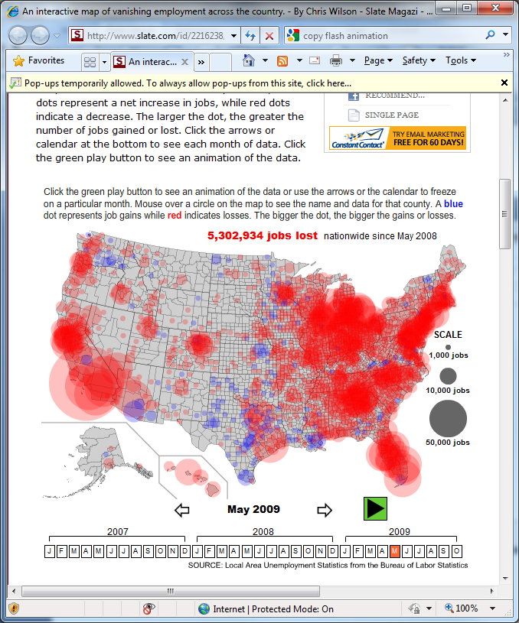

Slide 45
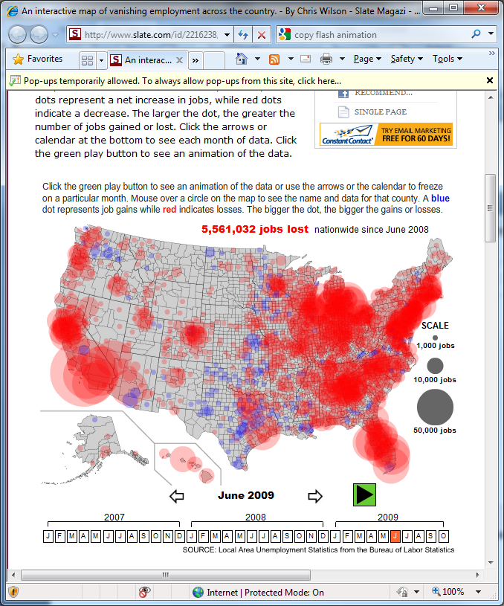

Slide 46
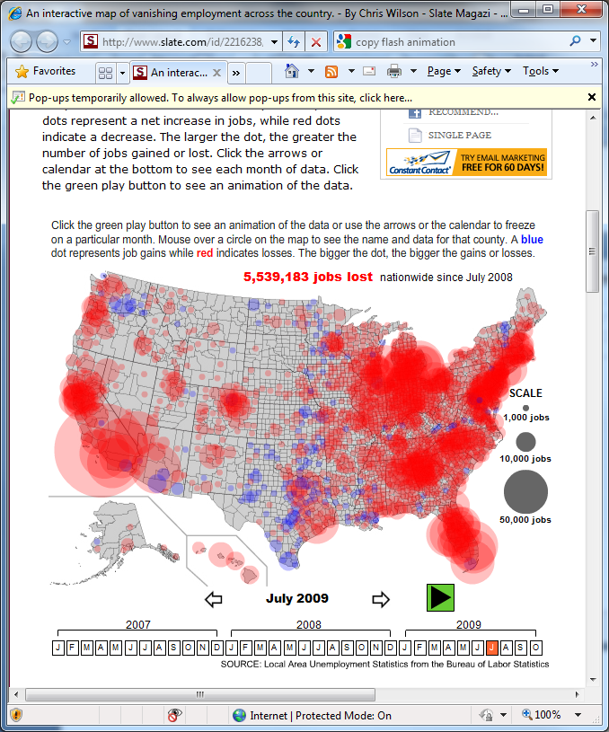

Slide 47
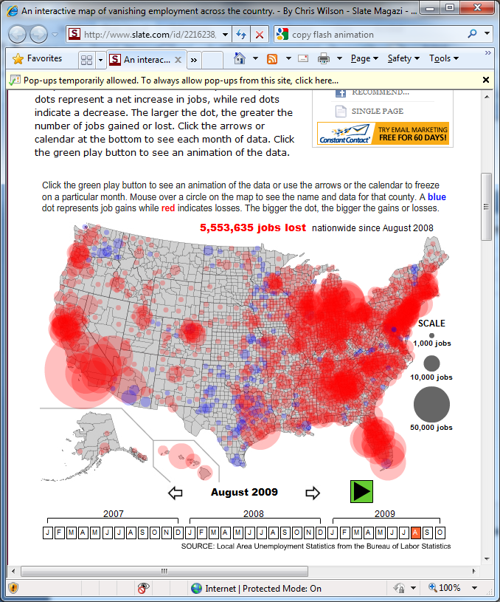

Slide 48
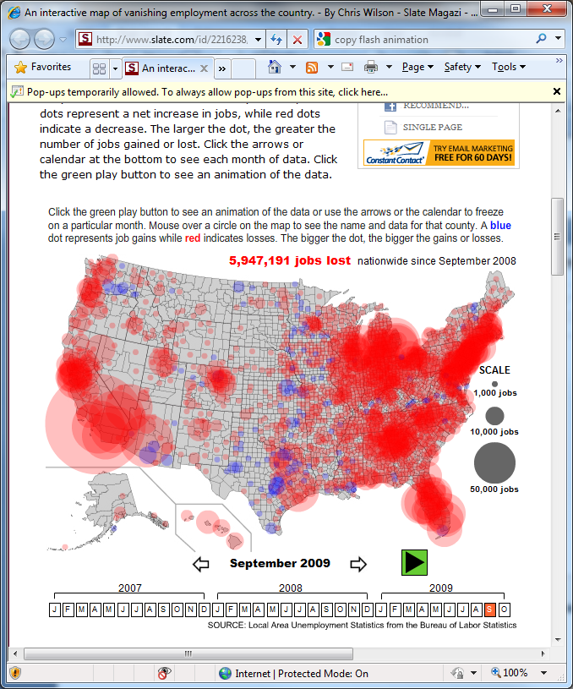

Slide 49

Slate.com

Slide 50
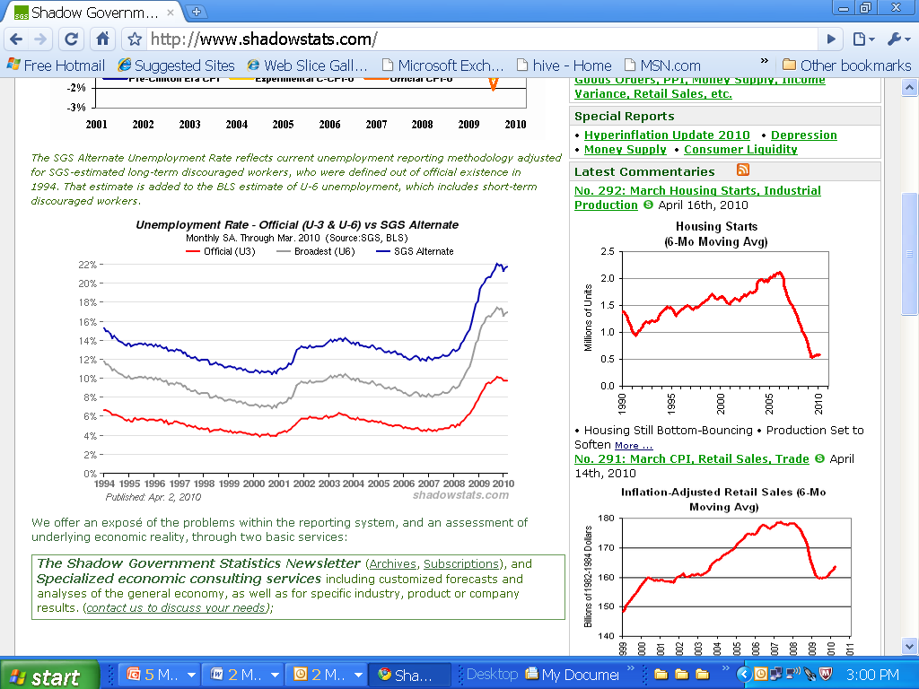
22%
9.7%

Slide 51

A Little History of the World
E. H. Gombrich
Anyone who owned a mechanical loom could, with the help of one or two assistants – perhaps his wife and children – do more work than a hundred trained weavers.
So whatever became of all the weavers in a town into which a mechanical loom was introduced? . . . they woke up one day to discover that they weren’t needed any more. Everything it had taken them years to learn, first as apprentices and then as journeymen, was useless.
Compression of wages
Restructuring of the economy
Those that adapt flourish
Those that could not . . .

Slide 52

In 1970, 74% of the middle class had a high school diploma or less education.
In 2007, only 39% of middle class had a high school diploma or less education.
Middle Class:
  Family income range from 35,000 to 91,000

Slide 53
Help Wanted – Projections of Jobs and Education Requirements through 2018. Carnevale, Smith and Strohl
“postsecondary education has become the gatekeeper to the middle class and the upper class”

Slide 54
What was said about Louisiana:
Nationally, 60% of jobs will require a postsecondary credential by 2018.
By 2018, more than 50% of jobs will require a postsecondary credential. Louisiana currently has a workforce with less than half of what will be needed.
Unless there are systemic changes, in 2018 Louisiana will:

Slide 55
rank 6th in the nation in the percentage of jobs for high school dropouts;
rank 5th in the nation in the percentage of jobs for high school graduates;
rank 50th in the nation for jobs requiring an associate degree;
rank 45th in the nation in the percentage of jobs for college graduates;
rank 47th in the nation in the percentage of jobs for people with graduate degrees and . . .

Slide 56
rank next to last in the percent of Jobs Requiring Postsecondary Education.
We are at a turning point. Louisiana has to decide whether to do a better job at educating its people or serve as a great conveniently located source for cheap labor.
What is our collective vision of what Louisiana will look like in the future?

Slide 57
Current percentage of young adults (25-34) with a college degree³
³ “College degree” means an associate degree, bachelor’s degree, or higher. National Center for Higher Education Management Systems (NCHEMS), 2008 (from U.S. Census Bureau, 2008 American Community Survey Public Use Microdata Sample File.) http://www.higheredinfo.org

Slide 58
La. given ‘F’ in skilled workers
Advocate business writer
The number and quality of skilled workers in Louisiana is dismal, according to a recent report evaluating the state’s manufacturing abilities.
The 2011 Manufacturing and Logistics National Report by the Center for Business and Economic Research at Ball State University in Indiana gave Louisiana a failing grade in the important area of “human capital.”
All 50 states were included in the study.

Slide 59



Time and Place
Those individuals, families, cities, states and –increasingly—countries with the most education are prospering, while those with the least higher education are experiencing relative and often absolute economic decline.
--Postsecondary Education OPPORTUNITY, June 2005.
For people and communities to thrive in the new economy they will need to have access to a good college and good health care.

Slide 60



Top 25 Cities for College Graduates
compiled by The Daily Beast published by Newsweek.
Fayetteville, NC
Omaha, Neb.
Oklahoma City, OK
Austin, TX
Houston, TX
Lexington, KY
Durham, NC
Dallas, TX
Tulsa, OK
Little Rock, AR
Savannah, GA
Washington D.C.
Boston, MA
Corpus Christi, TX
Baton Rouge, LA
New Orleans, LA
Des Moines, Iowa
Columbus, OH
Stanford, Conn.
Shreveport, LA
Seattle, WA
Albany, NY
San Antonio, TX
Kalamazoo, Michigan
Honolulu, Hawaii

Slide 61
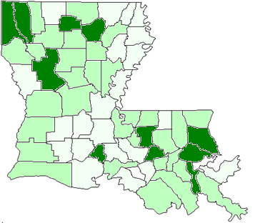
Percent of Parish Population With Bachelors and Higher---25 and older
State Average
20.64%
 | 20.0% - 32.2%
 | 12.0% - 19.9%
 | 8.3%- 11.9%
Source: Data Set: 2005-2009 American Community Survey 5-Year Estimates Survey

Slide 62
75% of persons with bachelor’s live in 8 parishes

Slide 63





Slide 64
Local Imperative
81% of Louisianans were born in Louisiana
The local population will be your workforce
Student preparation for college/work is key
Local support for local students is needed
Getting adults with with some college to complete their degree can be a strong mechanism for building local communities
Stewards of the community

Slide 65
Employment Rate by Degree Level
Eighteen Months after Graduation - For All Completers

Slide 66
Figure 5
Employment Rate by Field of Study
Eighteen Months after Graduation - For 2008-09 Bachelor’s Degree Completers

Slide 67
Employment Rate by Residency Status
Eighteen Months after Graduation - For All Completers
(Collective 2006-07, 2007-08, and 2008-09)
Max Degree Level | LA Residents |  | Non-Residents
 | Number of Completers | Percent Found Employed | Number of Completers | Percent Found Employed
Certificate | 3,900 | 60.9% | 74 | 27.0%
Diploma | 6,917 | 68.8% | 81 | 28.4%
Associate | 11,126 | 73.9% | 261 | 26.8%
Bachelor’s | 46,477 | 63.8% | 6,071 | 22.3%
Master’s | 9,882 | 69.2% | 3,228 | 22.7%
Doctoral | 590 | 55.4% | 794 | 15.4%
Professional | 2,180 | 53.0% | 286 | 20.3%

Slide 68
Figure 7
Employment Rate by Residency Status
Eighteen Months after Graduation - For All Completers
(Collective 2006-07, 2007-08, and 2008-09)

Slide 69
Table 5
Average Calculated Salary by Degree Level
For All Employed Completers
Max Degree Level | Eighteen Months after Graduation
 | 2006-07 | 2007-08 | 2008-09
Certificate | $23,000 | $24,778 | $23,622
Diploma | $30,607 | $30,062 | $28,530
Associate | $37,799 | $37,425 | $35,544
Bachelor | $35,099 | $34,115 | $32,742
Master | $48,737 | $49,644 | $48,016
Doctoral | $59,863 | $60,655 | $61,023
Professional | $65,368 | $67,315 | $66,786
As a result of the recession, compression of wages for new hires has occurred.
The trend in other states show that at five years in the workforce, bachelor’s degree recipients will earn more, on average, than associates.

Slide 70
Average Calculated Salary by Field of Study
Eighteen Months after Graduation - For 2008-09 Bachelor’s Degree Completers

Slide 71
Average Calculated Salary by Field of Study
For 2008-09 Associate Degree Completers
Field Of Study | Number of Completers | Wages Eighteen Months after Graduation
Agriculture, Agriculture Operations | 2 | --
Biological & Biomedical Sciences | 2 | --
Business, Management, Marketing | 429 | $25,347
Communication, Journalism | 12 | $20,305
Communications Technologies | 26 | $17,928
Computer & Information Sciences | 88 | $28,531
Education | 53 | $25,993
Engineering Technologies | 396 | $49,112
Family & Consumer Sciences | 52 | $18,149
Foreign Languages, Literatures | 6 | --
Health Professions | 957 | $46,784
Legal Professions | 19 | $28,572
Liberal Arts & Sci; General Studies | 555 | $23,584
Mechanic & Repair Technologies | 20 | $36,430
Multi/Interdisciplinary Studies | 22 | $19,352
Natural Resources & Conservation | 4 | --
Personal & Culinary Services | 32 | $27,178
Physical Sciences | 3 | --
Security & Protective Services | 161 | $30,031
Visual & Performing Arts | 39 | $19,001

Slide 72

At the end of WWII, the U.S made a bold decision to invest in the future of its economy by providing $1.9 billion annually to the education of returning veterans of the war. This commitment to human capital helped enable the WWII generation to become the “greatest generation.”
Possibly, this state’s greatest generation is at the schoolhouse door waiting for the opportunity to propel your state into the global economy.

