Slide 1

LA GRAD Act
LCTCS Conference
LA Board of Regents
March 2013

Slide 2

Today’s Objectives
Importance of Attachments A & B
Annual Report format
GRAD Act scoring overview
What’s new for year 3
Q & A

Slide 3

LA GRAD Act
Granting Resources and Autonomy for Diplomas
GRAD Act grants colleges and universities increased tuition authority and operational autonomies in exchange for commitment to meet clearly defined statewide performance goals.

Slide 4
LA GRAD Act Performance Objectives
Student Success
2. Articulation and Transfer
3. Workforce and Economic Development
4. Institutional Efficiency and Accountability

Slide 5

GRAD Act Measures
  For each of the four performance objectives, there are performance elements & measures.
  GRAD Act measures
    Vary by institutions’ specific role, scope & mission.
    Institutions compete against themselves
      Meet established targets or
      Improvement over previous years
  There are three categories of measures:
    DESCRIPTIVE
    TRACKED
    TARGETED

Slide 6
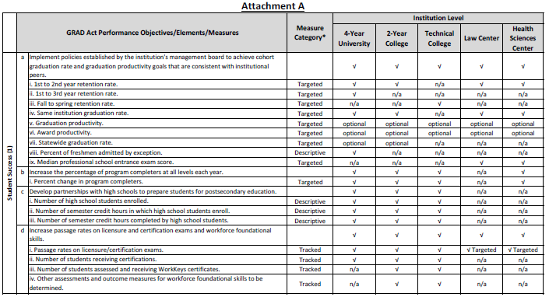
GRAD Act Performance Measures
Performance Objectives
Measures
Elements

Slide 7
GRAD Act Annual Report Format
  Annual reports are submitted to the BoR through the system office in both hard & electronic copy.
  Report Format
  COVER LETTER from the institution head, including identification of point of contact for the report
  NARRATIVES should be titled with specific Performance Objective. Narratives MAY incorporate data but WILL NOT be considered official submission of targeted data. NOTE: points may deducted for exceeding maximum number of pages.
  DATA for the Measures will be submitted via the BoR GRAD Act Online Reporting System, except where noted. Some data will be preloaded by BoR into the system. Institutions must submit a printed copy of their data with their annual report.

Slide 8
GRAD Act Annual Review Timeline
April: Institutions submit annual reports to their Management Boards
May 1: Mgt Boards certify/verify reports & submit to BoR
May/June: Regent’s staff completes scoring
June: Preliminary designation at least 20 days prior to BoR Meeting
June: Institution has up to 10 days prior to BoR meeting to respond to preliminary designation
June 26th/27th: Final status determination after formal board review and action during BoR meeting
July 15: BoR submits Annual Report to Governor & Legislature

Slide 9
GRAD Act Scoring
A score is given for each applicable criterion.
Points are assigned as follows:
  Targeted measures: worth 2 points if
  target has been met OR
  target met within allowable tolerance OR
  if institution has shown progress in measure when comparing most recent 2 yr avg to the prior 3 yr average (this requires institution to submit 5 years of data)
  Tracked & Descriptive measures: worth 1 point if required data are reported.
  Narratives for each performance objective: worth up to 20% of total possible points in each performance objective.

Slide 10
GRAD Act Scoring Example
Score for Performance Objective 1: Student Success
POSSIBLE SCORE
a. Score value total = 11
b. Objective narrative (20% of a.) = 2.2
c. a. + b. = 13.2
ACTUAL SCORE
d. Score total = 9
e. Objective narrative score (up to b.) = 1.9
f. d. + e. = 10.9
PERCENT SCORE: Actual score(10.9)/Possible score(13.2) = 82.6= 83%

Slide 11
GRAD Act Scoring
Percent change in Completers: “Rolling it up”
When scoring completers, 2 issues arose:
(1) small number of awards at some levels (especially certificates, diplomas, masters and doctorates)
(2) wider variety of award levels at 4-year campuses compared to two-year and technical colleges
Decision was made to collapse/combine degree levels so that the potential score value for completers would be the same for two- and four-year campuses.

Slide 12
GRAD Act Scoring
  Percent change in Completers (continued)
2 yr colleges and technical colleges: (4 possible points)
  < Associate (certificate and diploma) 2 points
  Associate (associate and post assoc) 2 points
4 yr and health science centers: (4 possible points)
  Undergraduate (baccalaureate and post bacc) 2 points
  Graduate (all levels above graduate) 2 points
BoR will score both ways (levels segregated and collapsed) & the institution will be given the more favorable score.

Slide 13

Passing GRAD Act
Authority to raise tuition & eligible for autonomies
Receive performance funding
  Institutions not passing GRAD Act may be eligible to earn up 75% their performance funds by entering into GRAD Act Improvement Contract Policy

Slide 14
GRAD Act – What’s New
March 15: Last day for BoR data files to be submitted
→ Requests to submit data after this deadline must be submitted for Board approval
Online reporting system: BoR has pre-populated year 3 data
→ campuses should review & address discrepancies
→ campuses should fill in any applicable fields that are not pre-populated
→ will be repository for GRAD Act data
→ BoR will use these data for annual report and in 6 year report to Governor & Legislature

Slide 15
GRAD Act – What’s New
Tracked to Targeted/New Targeted Measures
  BoR held several meetings with system liaisons
  Goal was to respond to GRAD Act Agreement which states that consideration be given to converting applicable tracked measures to targeted measures after year 2
  Institutions were required to select a minimum of ONE new targeted measure for each of the 4 objectives
  Late 2012/early 2013: Board approves new targeted measures, targets & end of agreement benchmarks

Slide 16
GRAD Act – Points to Remember
ALWAYS refer to Attachments A & B when compiling data and preparing the annual report.
For narratives, report on activities/outcomes that occurred during the reporting year in support of the Elements in the Performance Objective – refer to suggested items in Attachment B.
If you have a question, don’t guess – ASK!

Slide 17

For more information……
www.regents.state.la.us
LeAnn Detillier, Assistant Commissioner
for Program Administration
leann.detillier@la.gov * (225) 342-4253

